Slide 1

Predicting Diabetes
Using Machine Learning Models
Laura Faulds
Emad Moro
Manisha Reza Paul
Rafia Tazeen

Slide 2

Motivation
11.7 million Canadians are currently living with diabetes or prediabetes (Source: diabetes.ca)
Every day, 640 Canadians (or 1 person every 3 minutes) are diagnosed with diabetes (Source: diabetes.ca)
We wanted to use Machine Learning to identify which diabetes risk factors contribute most significantly to a diagnosis
These predictive models could ultimately lead to greater insight in the realm of diabetes prevention and support

Slide 3

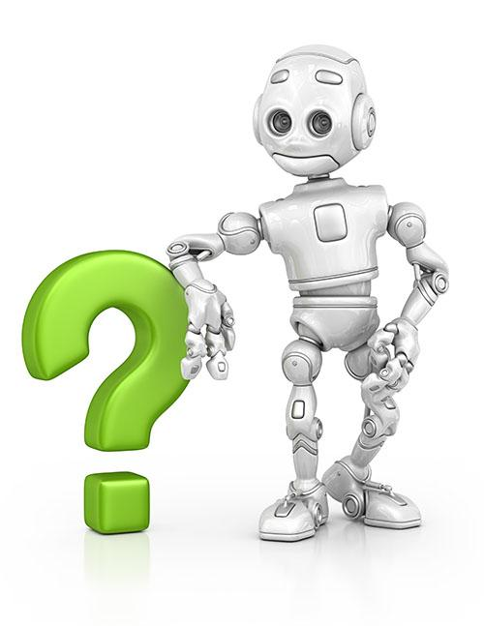
2. Primary Question
How can we use machine learning models to figure out relationships between different medical & demographic factors and link them to the possibility of developing diabetes?

Slide 4

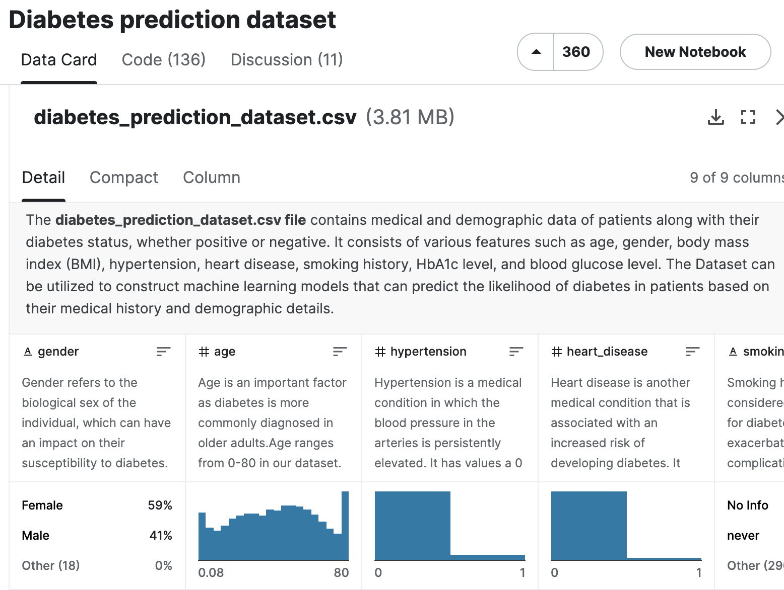
3. Data Description & Collection
We found our dataset on Kaggle
After learning the hard way in Project 3 that an imperfect data set can make everyone’s lives a lot harder, we focused on finding a functional & organized dataset that had been used successfully by many others in the past
The dataset provided us with many useful features as well as a clearly defined target variable

Slide 5
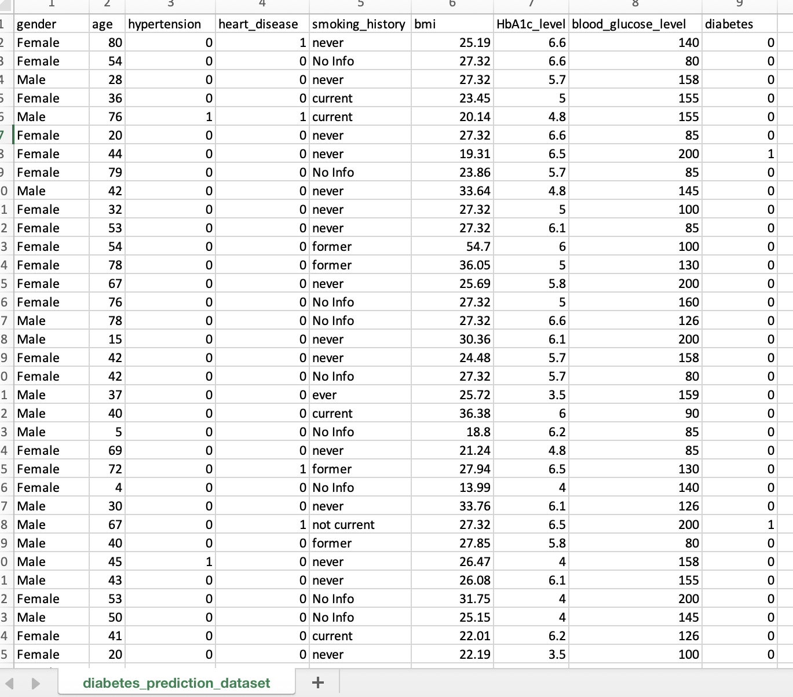

Here is our dataset in its original form!
It had 100001 rows and 9 columns
It contained data types of int64, float64, and object
We noticed that all ages under 3 yrs were listed as confusing decimals (i.e. 0.43, 0.75) so we eliminated them from our dataset, leaving us with 96,695 rows
While we loved the inclusion of the “diabetes” target variable, the confusing “smoking_history” column was an obvious red flag

Slide 6
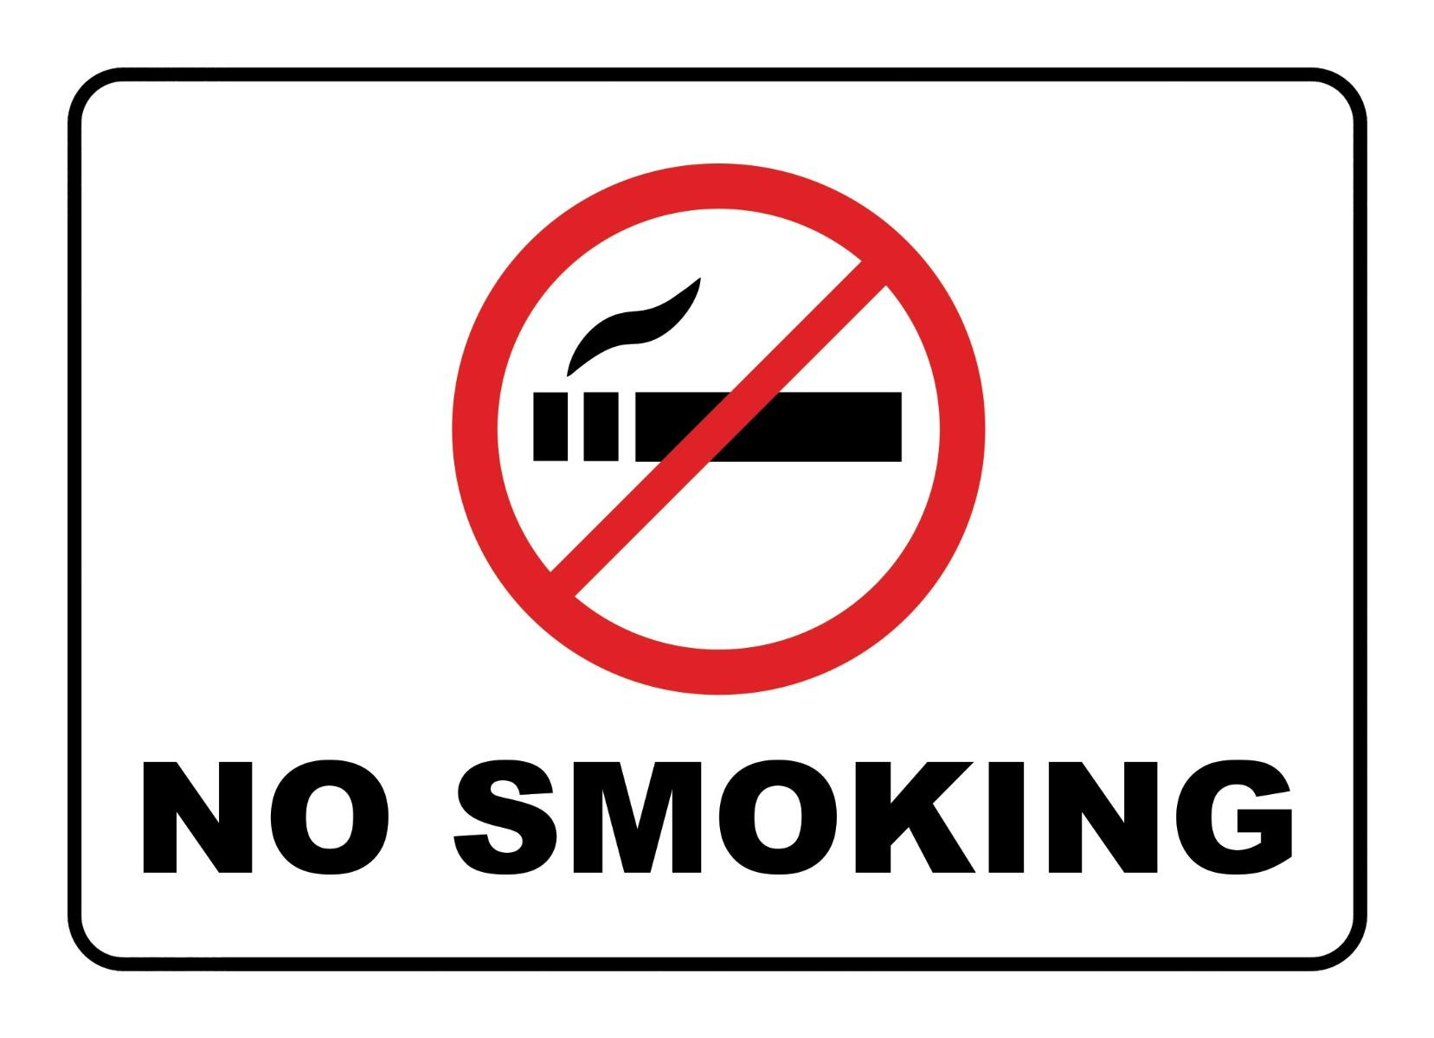
4. Data Cleaning
Original distribution of the smoking_history column:
never 34824
No Info 32840
former 9352
current 9276
not current 6417
ever 4004
Name: smoking_history, dtype: int64
After much deliberation, we decided to merge the “not current” category into the “former” category and the “ever” category into “occasional” for clarity, resulting in the following distribution:
never 34824
No Info 32840
former 15769
current 9276
occasional 4004
Name: smoking_history, dtype: int64
We then used pd.get_dummies to one-hot encode the smoking_history and gender columns

Slide 7
5. Problem Formulation, EDA & Experimentation
Because our data set was organized around a target variable that related directly to our primary question, our problem formulation was straightforward:
We separated our target variable (diabetes: yes or no) from the rest of the features, split the data using train_test_split, and ran Logistic Regression as our baseline model
This gave us an accuracy score of 95.7%, which made us feel very optimistic!
We then generated a Confusion Matrix for the model and printed a classification report:

Slide 8
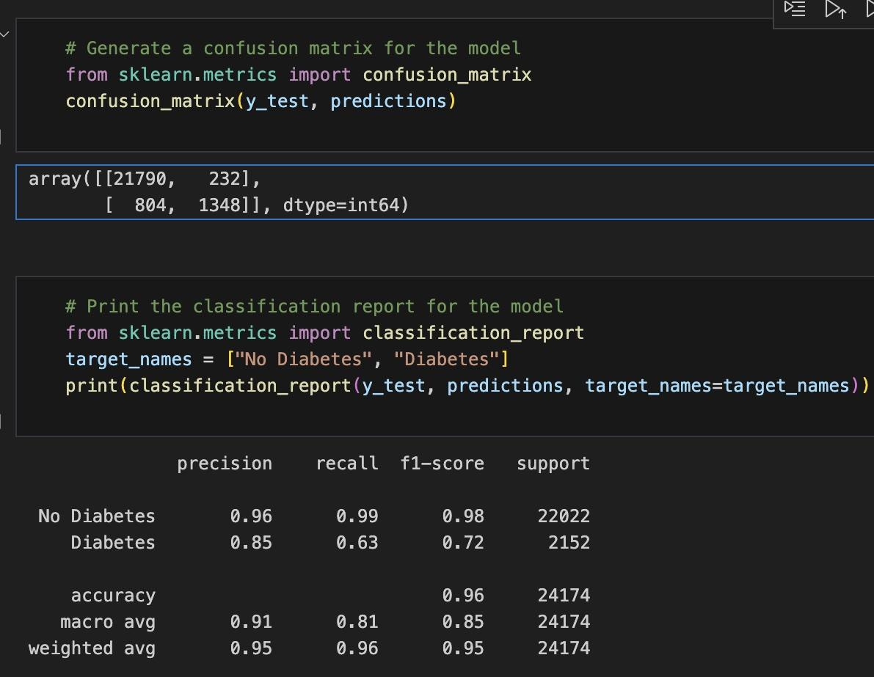
It was clear that this model was functioning well in its ability to predict the No Diabetes category, but was struggling with the Diabetes category (63% recall, F1-score of 72%)
We figured this was likely due to an imbalance in our dataset: running a value_count on our target variable showed that we were working with 88,195 rows in the No Diabetes category and only 8500 in Diabetes

Slide 9
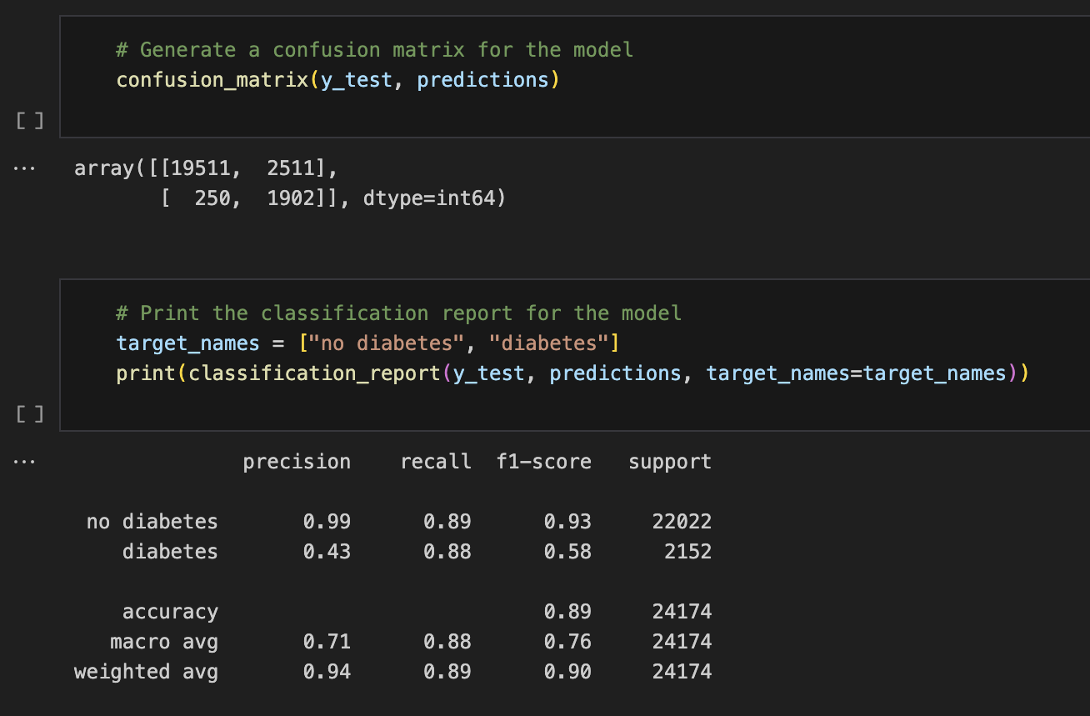
We used RandomOverSampler for our second attempt
It gave us a higher recall rate but a lower precision rate and F1-score in the Diabetes category

Slide 10


Slide 11

We then created a deep neural network model using:
Relu & Sigmoid activation functions
Two hidden layers
80 and 30 nodes
This model gives us consistent accuracy rates hovering around the 97% mark.
Success!

Slide 12
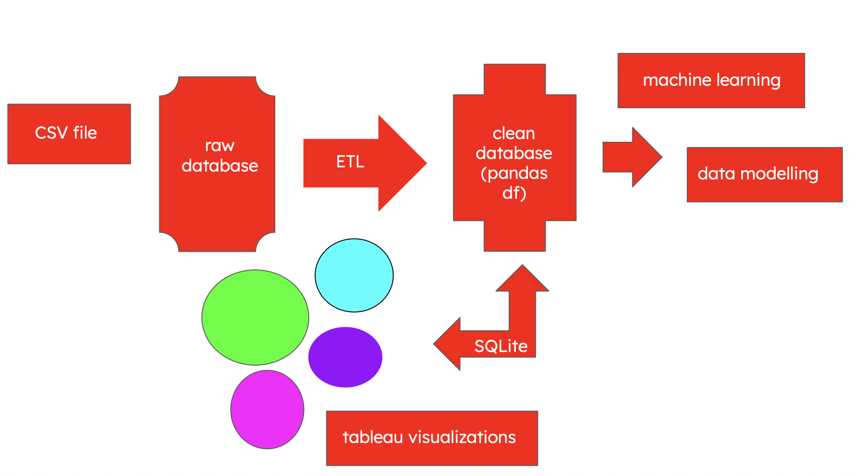
6. Solution Architecture
Our finalized model can be used by hospitals, research clinics, and nonprofits
A SQLite database has been created for storage of data pertaining to the diabetes risk factors our model requires to function
This database can then be read into VSCode or Google Colab where the neural network can be employed
Tableau can be used to gain further insight into the model’s predictions

Slide 13

Time for our demo!

Slide 14
7. Summary
Although we had more female respondents than male respondents, a higher percentage of male respondents are diabetic: 7.22% of females with diabetes w/ percentages, 9.62% of males with diabetes w/ percentages
Using BMI, We also observed a large amount of our respondents that were ‘Obese’ also had Diabetes (> 18%), while there were very few amounts of respondents that were ‘Underweight’ that also had diabetes (<1%). BMI on average was higher in those that have diabetes as opposed to those who do not
In our dataset, those that had diabetes on average had a higher blood glucose level than those that don’t have diabetes
With Smoking habits, we found that former smokers had a larger amount of responses from those that have diabetes than those that are non-smokers. In comparison, current and occasional smokers had a relatively equal weight in respondents with diabetes.

Slide 15
8. Limitations
Our dataset did not mention the type of diabetes (Type 1 or Type 2) that the individual had. This is an important distinction because Type 1 diabetes is usually diagnosed in children & young adults, whereas Type 2 is more common in older adults
Another limitation is the lack of information on family history. Diabetes is also a genetically predisposed disease so it can be monitored and dealt with early if there is knowledge of prior family history of diabetes
Lastly, because the dataset was skewed, accuracy might not be the most reliable measure of the model’s performance.

Slide 16
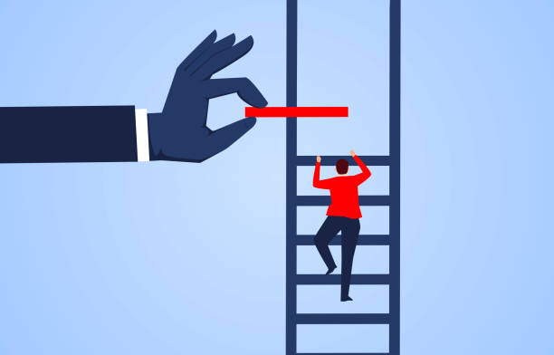
9. Next Steps
Add more info about the type of diabetes diagnosed along with family history to the dataset
In terms of data modelling: we can try to remove the skewness of the distribution so the accuracy can be more reliable.
Alternatively, we can use different metrics to evaluate the performance of the model such as Matthews Correlation Coefficient (MCC) or Phi-Value.

Slide 17


The most important lesson we learned this project was: pick the right dataset!
Having a clean & functional dataset allowed us to spend more time on our visualizations and helped us have a stress and headache-free Project 4 experience
However, in the real world, we might not be so lucky with our data set. Data accuracy & completeness are key in ensuring that an ML model will function effectively, & we are aware that this dataset was developed for educational purposes

Slide 18
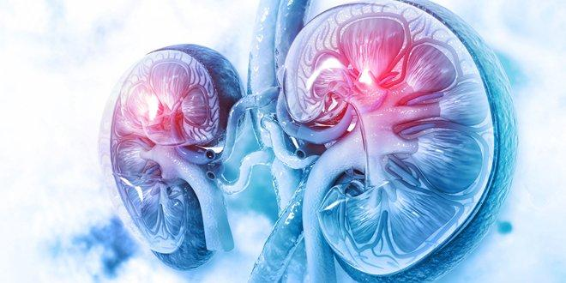
10. Citations
https://www.kaggle.com/datasets/iammustafatz/diabetes-prediction-dataset/data
https://www.hopkinsmedicine.org/health/conditions-and-diseases/diabetes/diabetes-and-high-blood-pressure
https://www.kaggle.com/code/chemistahmedkamel/eda-diabetes-prediction-with-lowest-error
https://diatribe.org/whats-story-bmi

Slide 19

Thank you to Bharat, Mahesh & TAs for an amazing six months!!!!
Best of luck, everyone!

